Slide 1



Lungs Disease Pneumonia Detection on x-ray Deep Leaning AI
Streamlit Web Application
Project By:
Muneer Iqbal F22BARIN7M01010
Aqsa Rasheed F22BARIN7M01031
M Ashraf F22BARIN7M01014

Slide 2
Contents
Brief overview of the project
Problem statement: AI Base Lungs Disease Pnemonia Classification using X-Ray image

Slide 3


Introduction
- Brief overview of the project
- Problem statement: Lungs Disease Pnemonia Detection Using X-ray Images
- Objective: To develop a model that accurately detects specific disease pneumonia affected or not
-Deep Learning (CNN)
-Library (TensorFlow)
-Dataset (www.kaggle.com)
-Hosted (streamlit website)
Predict(Pnemonia Affected Pnemonia Not Affected)

Slide 4

Model Architecture
01
- Number of layers: 3 convolutional layers followed by 2 dense layers
- Activation functions: ReLU for convolutional layers, softmax for output layer
02
Data set loading
preprocessing
-Set Image dimensions
Scaling
- Description of the Convolutional Neural Network (CNN) architecture used
03
- Summary of the model's parameters

Slide 5
Data Preprocessing
- Overview of data preprocessing steps
Rescaling images to [0, 1] range
Resize the images in one scale
Image dimension (150,150)
- Train-test split with 80-20 ratio
Image augmentation techniques (if used)
-Model Compilation(using Adam optimizer)

Slide 6
Training the Model
- Description of the training process
- Optimizer: Adam
- Loss function: Categorical cross-entropy
- Number of epochs: 5
- Training and validation accuracy/loss plots
Instruments
Protection and security
Equipment

Slide 7
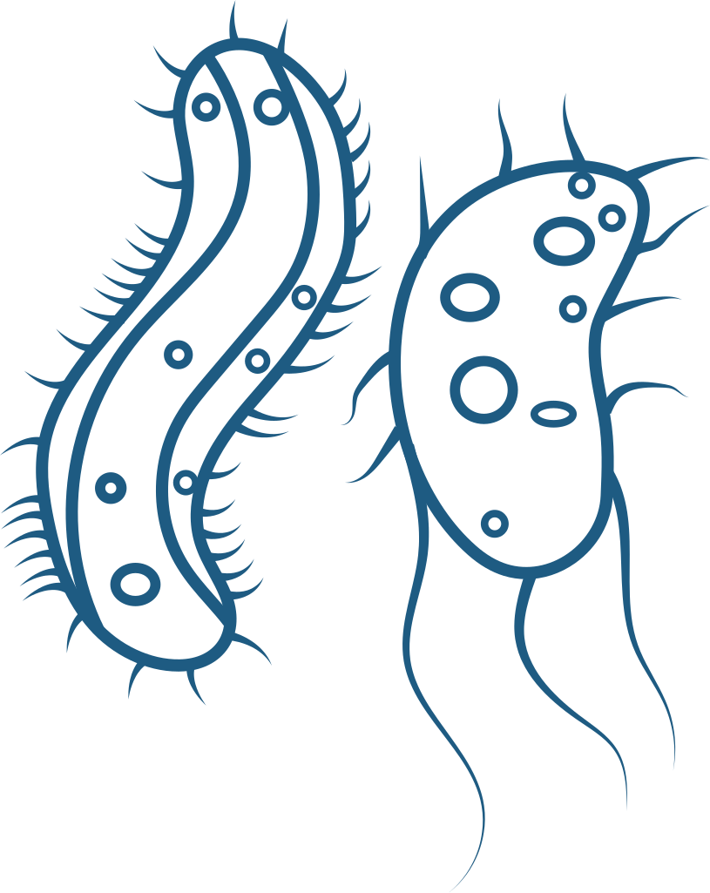
Model Evaluation
- Evaluation metrics used: Accuracy 99%
- Validation accuracy achieved: 87.52%

Slide 8

- Overview of the predictive system
- Function to load and preprocess images
Predictive System
Function to predict the class of an image
1. pneumonia Affected
2. pneumonia not affected
- Example usage with an image
Upload an image
Click on predict button
See results

Slide 9
Project Impact
- How does the project solve the problem?
- Increased accuracy in pnemonia disease detection
- Faster diagnosis leading to timely treatment
- Potential to reduce misdiagnosis rates and improve patient outcomes

Slide 10
CONCLUSION
- Recap of key points covered in the presentation
- Future improvements or extensions to the project

Slide 11
QNA
- Open the floor for questions from the audience
This outline provides a concise overview of your skin disease detection project, focusing on the model architecture, training process, evaluation metrics, and the impact of the project. You can expand each point with relevant details and visuals in your PowerPoint presentation.

